Slide 1

Shock
CHAPTER 13

Slide 2
National EMS Education Standard Competencies (1 of 2)
Shock and Resuscitation
Applies a fundamental knowledge of the causes, pathophysiology, and management of shock, respiratory failure or arrest, cardiac failure or arrest, and postresuscitation management.
Notes:
National EMS Education Standard Competencies
Shock and Resuscitation
Applies a fundamental knowledge of the causes, pathophysiology, and management of shock, respiratory failure or arrest, cardiac failure or arrest, and post resuscitation management.

Slide 3
National EMS Education Standard Competencies (2 of 2)
Pathophysiology
Applies fundamental knowledge of the pathophysiology of respiration and perfusion to patient assessment and management.
Notes:
National EMS Education Standard Competencies
Pathophysiology
Applies fundamental knowledge of the pathophysiology of respiration and perfusion to patient assessment and management.

Slide 4
Introduction
Shock (hypoperfusion) is defined as inadequate cellular perfusion.
  Any compromise in perfusion can lead to cellular injury or death.
  In the early stages, the body attempts to maintain homeostasis.
Notes:
Lecture Outline
I. Introduction
A. In this chapter, shock (hypoperfusion) is defined as inadequate cellular perfusion.
1. Any compromise in perfusion can lead to cellular injury or death.

Slide 5
Pathophysiology (1 of 12)
Diffusion is a passive process in which molecules move from an area with a higher concentration of molecules to an area of lower concentration.
  Oxygen and carbon dioxide move across the walls of the alveoli.
Notes:
Lecture Outline
B. Diffusion is a passive process in which molecules move from an area with a higher concentration of molecules to an area of lower concentration.
1. This is how oxygen and carbon dioxide cross the walls of the alveoli.
2. The majority of oxygen is carried to the tissues attached to hemoglobin.
3. Carbon dioxide can be transported in the blood from tissues back to the lungs in three ways:
a. Dissolved in the plasma
b. Combined with water in the form of bicarbonate
c. Attached to hemoglobin
4. Carbon dioxide waste products released from cells can combine with water in the bloodstream to form bicarbonate.
5. Once it reaches the lungs, the bicarbonate breaks back down into carbon dioxide and water and the carbon dioxide is exhaled.

Slide 6
Pathophysiology (2 of 12)
In cases of poor perfusion (shock):
  Transportation of carbon dioxide out of tissues is impaired.
  Results in a dangerous buildup of waste products, which may cause cellular damage
Notes:
Lecture Outline
6. In cases of poor perfusion (shock), the transportation of carbon dioxide out of the tissues will become impaired, resulting in a dangerous buildup of waste products, which may cause cellular damage.

Slide 7
Pathophysiology (3 of 12)
Shock is a state of collapse and failure of the cardiovascular system that leads to inadequate circulation.
  Early recognition can save lives.
  Requires immediate recognition and rapid treatment
Notes:
Lecture Outline
C. Shock refers to a state of collapse and failure of the cardiovascular system that leads to inadequate circulation.
1. To protect vital organs, the body directs blood flow from organs that are more tolerant of low flow (such as the skin and intestines) to organs that cannot tolerate low blood flow (such as the heart, brain, and lungs).
2. Early recognition of the signs and symptoms of shock can save lives
3. Shock is life threatening and requires immediate recognition and rapid treatment.

Slide 8
Pathophysiology (4 of 12)
Cardiovascular system consists of three parts:
  Pump (heart)
  Set of pipes (blood vessels or arteries)
  Contents (the blood)
Notes:
Lecture Outline
D. The cardiovascular system consists of three parts:
1. The heart (pump), blood vessels (container), and blood (content)

Slide 9
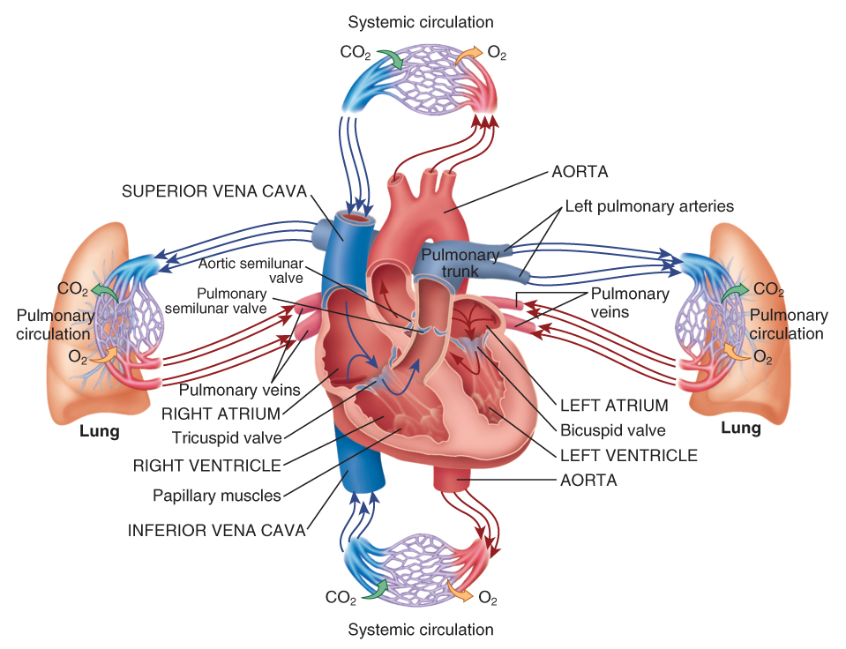
Pathophysiology (5 of 12)
FIGURE 13-1 The cardiovascular system consists of three parts: the pump (heart), the container (vessels), and the contents (blood). The blood carries oxygen and nutrients through the vessels to the capillary beds, where they diffuse into the tissue; in exchange, waste products diffuse into the bloodstream.
© Jones & Bartlett Learning.
Notes:
The figure on this slide illustrates the cardiovascular system.

Slide 10
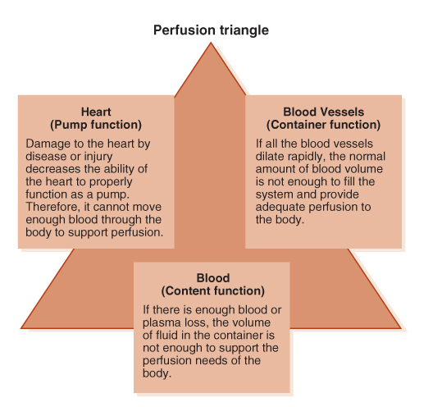
Pathophysiology (6 of 12)
“Perfusion triangle.”
  When a patient is in shock, one or more of the three parts is not working properly.
FIGURE 13-2 The heart, the blood vessels, and the blood represent the three parts of perfusion (the perfusion triangle).
© Jones & Bartlett Learning.
Notes:
Lecture Outline
a. These three parts can be referred to as the “perfusion triangle.”
b. When a patient is in shock, one or more of the three parts is not working properly.

Slide 11
Pathophysiology (7 of 12)
Blood pressure is the pressure of blood within the vessels at any moment in time.
  Systolic: peak arterial pressure
  Diastolic: pressure in the arteries while the heart rests between heartbeats
Notes:
Lecture Outline
E. Blood pressure is the pressure of blood within the vessels at any moment in time.
1. Systolic pressure is the peak arterial pressure, or pressure generated every time the heart contracts.
2. Diastolic pressure is the pressure maintained within the arteries while the heart rests between heartbeats.

Slide 12
Pathophysiology (8 of 12)
Pulse pressure is the difference between the systolic and diastolic pressures.
  It signifies the amount of force the heart generates with each contraction.
  A pulse pressure less than 25 mm Hg may be seen in patients with shock.
Notes:
Lecture Outline
3. Pulse pressure is the difference between the systolic and diastolic pressures (systolic – diastolic = pulse pressure).
a. It signifies the amount of force the heart generates with each contraction.
b. A pulse pressure less than 25 mm Hg may be seen in patients with shock.

Slide 13
Pathophysiology (9 of 12)
Blood flow through the capillary beds is regulated by the capillary sphincters.
  Under the control of the autonomic nervous system
  Regulation of blood flow is determined by cellular needs.
Notes:
Lecture Outline
F. Blood flow through the capillary beds is regulated by the capillary sphincters (circular muscular walls that constrict and dilate).
1. These sphincters are under the control of the autonomic nervous system, which regulates involuntary functions such as sweating and digestion.
2. Capillary sphincters also respond to other stimuli, such as:
a. Heat
b. Cold
c. The need for oxygen
d. The need for waste removal
3. Regulation of blood flow is determined by cellular needs.

Slide 14
Pathophysiology (10 of 12)
Perfusion also requires adequate:
  Oxygen exchange in the lungs
  Nutrients in the form of glucose in the blood
  Waste removal, primarily through the lungs
Notes:
Lecture Outline
G. Perfusion also requires adequate:
1. Oxygen exchange in the lungs
2. Nutrients in the form of glucose in the blood
3. Waste removal, primarily through the lungs

Slide 15
Pathophysiology (11 of 12)
Mechanisms are in place to help support the respiratory and cardiovascular systems when the need for perfusion of vital organs is increased.
  Includes the autonomic nervous system and hormones
Notes:
Lecture Outline
H. Mechanisms are in place to help support the respiratory and cardiovascular systems when the need for perfusion of vital organs is increased.
1. Includes the autonomic nervous system and hormones

Slide 16
Pathophysiology (12 of 12)
Hormones are triggered when the body senses pressure falling.
  Cause an increase in:
    Heart rate
    Strength of cardiac contractions
    Peripheral vasoconstriction
This response causes all the signs and symptoms of shock.
Notes:
Lecture Outline
a. The sympathetic side of the autonomic nervous system, which is responsible for the fight-or-flight response, will assume more control of the body’s functions during a state of shock.
b. This response by the autonomic nervous system causes the release of hormones such as epinephrine and norepinephrine.
c. Hormones cause an increase in heart rate and in the strength of cardiac contractions, as well as vasoconstriction in nonessential areas, primarily in the skin and gastrointestinal tract (peripheral vasoconstriction).
d. This response causes all the signs and symptoms of shock in a patient.

Slide 17
Causes of Shock (1 of 3)
Many different shocks result from three basic causes:
  Pump failure
  Poor vessel function
  Low fluid volume
Notes:
Lecture Outline
III. Causes of Shock
A. There are many different types of shock that result from three basic causes: pump failure, poor vessel function, and low fluid volume (See Table 13-1).

Slide 18
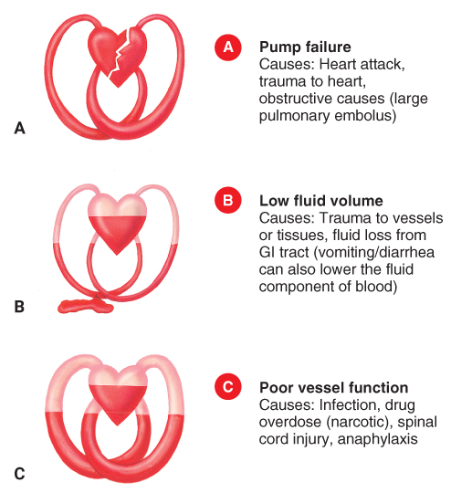
Causes of Shock (2 of 3)
FIGURE 13-3 There are three basic causes of shock and impaired tissue perfusion. A. Pump failure occurs when the heart is damaged by disease or injury, or when an obstruction prevents it from functioning. B. Low fluid volume, often a result of bleeding. C. The blood vessels can dilate excessively so that the blood within them is inadequate to fill the system.
© Jones & Bartlett Learning.
A, B, C: © Jones & Bartlett Learning.
Notes:
The illustration on this slide shows the three basic causes of shock and impaired tissue perfusion. A. Pump failure. B. Low fluid volume. C. Poor vessel function.

Slide 19
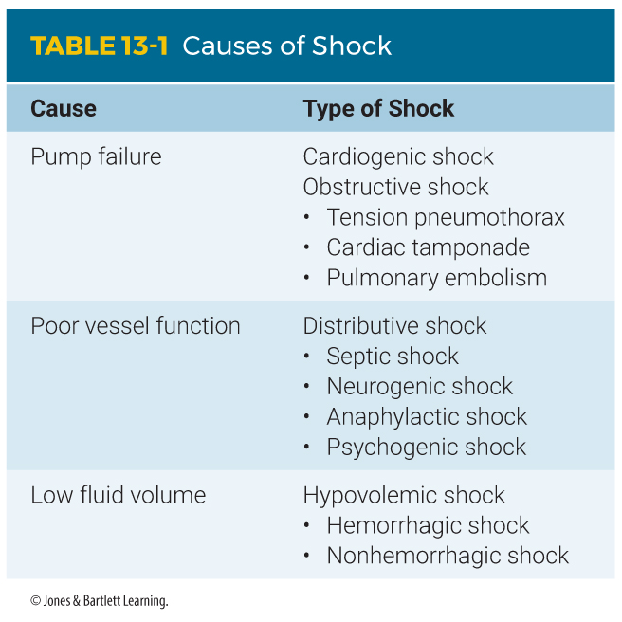
Causes of Shock (3 of 3)
Notes:
The table on this slide lists the types of shock resulting from three basic causes.

Slide 20
Cardiogenic Shock (1 of 2)
Caused by inadequate function of the heart
A major effect is the backup of blood into the pulmonary vessels.
Resulting buildup of pulmonary fluid is called pulmonary edema.
Notes:
Lecture Outline
IV. Types of Shock
A. Cardiogenic shock
1. Caused by inadequate function of the heart, or pump failure.
2. A major effect is the backup of blood into the pulmonary vessels.
3. The resulting buildup of pulmonary fluid is called pulmonary edema.

Slide 21
Cardiogenic Shock (2 of 2)
Cardiogenic shock develops when the heart cannot maintain sufficient output to meet the demands of the body.
Cardiac output depends on adequate:
  Contractility of the heart muscle
  Amount of blood to pump (preload)
  Resistance to flow in peripheral circulation (afterload)
Notes:
Lecture Outline
4. Cardiogenic shock develops when the heart cannot maintain sufficient output to meet the demands of the body.
a. Cardiac output is the volume of blood that the heart can pump per minute, and it is dependent upon several factors.
i. The heart must have adequate strength, which is largely determined by the ability of the heart muscle to contract (myocardial contractility).
ii. The heart must receive adequate blood to pump (preload).
iii. The resistance to flow in the peripheral circulation must be appropriate (afterload).

Slide 22
Obstructive Shock (1 of 4)
Caused by a mechanical obstruction that prevents an adequate volume of blood from filling the heart chambers.
Three of the most common examples:
  Cardiac tamponade
  Tension pneumothorax
  Pulmonary embolism
Notes:
Lecture Outline
B. Obstructive shock
1. Obstructive shock is caused by a mechanical obstruction that prevents an adequate volume of blood from filling the heart chambers.
2. Three of the most common examples:
a. Cardiac tamponade
b. Tension pneumothorax
c. Pulmonary embolism

Slide 23
Obstructive Shock (2 of 4)
Cardiac tamponade
  Collection of fluid between the pericardial sac and the myocardium (pericardial effusion) becomes large enough to prevent ventricles from filling with blood.
  Caused by blunt or penetrating trauma
  Signs and symptoms are referred to as Beck triad.
Notes:
Lecture Outline
a. Cardiac tamponade (pericardial tamponade)
i. A collection of fluid between the pericardial sac and the myocardium is called a pericardial effusion. If the effusion becomes large enough, it can prevent the ventricles from filling with blood—a condition called cardiac tamponade.
ii. Caused by blunt or penetrating trauma that causes hemorrhage around the heart.
iii. Signs and symptoms of cardiac tamponade are referred to as Beck triad: the presence of jugular vein distention, muffled heart sounds, and a narrowing pulse pressure where the systolic and diastolic blood pressures start to merge.

Slide 24
Obstructive Shock (3 of 4)
Tension pneumothorax
  Caused by damage to lung tissue
  Air normally held within the lung escapes into the chest cavity.
  The lung collapses, and air applies pressure to the organs, including the heart and great vessels.
Notes:
Lecture Outline
b. Tension pneumothorax
i. Caused by damage to lung tissue
ii. Air normally held within the lung escapes into the chest cavity.
iii. The lung collapses, and if the pneumothorax is left untreated, air will accumulate in the chest cavity and apply pressure to the organs, including the heart and great vessels.

Slide 25
Obstructive Shock (4 of 4)
Pulmonary embolism
  A blood clot that blocks the flow of blood through pulmonary vessels
  If massive:
    Can result in complete backup of blood in the right ventricle
    Leads to catastrophic obstructive shock and complete pump failure
Notes:
Lecture Outline
c. Pulmonary embolism
i. A blood clot that occurs in the pulmonary circulation that blocks the flow of blood through the pulmonary vessels.
ii. When a massive pulmonary embolism occurs, it can prevent blood from being pumped from the right side of the heart to the left, resulting in complete backup of blood in the right ventricle and leading to catastrophic obstructive shock and complete pump failure.

Slide 26
Distributive Shock (1 of 8)
Results from widespread dilation of small arterioles, small venules, or both
The circulating blood volume pools in the expanded vascular beds.
Tissue perfusion decreases.
Notes:
Lecture Outline
C. Distributive shock
1. Results when there is widespread dilation of small arterioles, small venules, or both
2. The circulating blood volume pools in the expanded vascular beds and tissue perfusion decreases.

Slide 27
Distributive Shock (2 of 8)
Septic shock
  Occurs as a result of severe infections in which toxins are generated by bacteria or by infected body tissues
  Toxins damage vessel walls, causing increased cellular permeability.
  Vessel walls leak and are unable to contract well.
Notes:
Lecture Outline
3. Septic shock
a. Occurs as result of severe infections, usually bacterial, in which toxins are generated by the bacteria or by infected body tissues.
b. Widespread dilation of vessels, combined with plasma loss through the injured vessel walls, results in shock.

Slide 28
Distributive Shock (3 of 8)
Septic shock (cont’d)
  Widespread dilation of vessels, in combination with plasma loss through the vessel walls, results in shock.
Notes:
Lecture Outline
b. Widespread dilation of vessels, in combination with plasma loss through the injured vessel walls, results in shock.

Slide 29
Distributive Shock (4 of 8)
Neurogenic shock
  Usually the result of high spinal cord injury
  Nerve impulses to blood vessels below the level of the injury are blocked.
  All vessels cut off from nerve impulses will dilate, causing the blood to pool.
Notes:
Lecture Outline
4. Neurogenic shock
a. Usually the result of high spinal-cord injury
b. Muscles in the walls of the blood vessels are cut off from the sympathetic nervous system and nerve impulses that cause them to contract.
c. All vessels below the level of the spinal cord injury dilate widely, increasing the size and capacity of the vascular system, causing blood to pool.

Slide 30
Distributive Shock (5 of 8)
Anaphylactic shock
  Occurs when a person reacts violently to a substance to which he or she has been sensitized
  Sensitization means becoming sensitive to a substance that did not initially cause a reaction.
  Each subsequent exposure tends to produce a more severe reaction.
Notes:
Lecture Outline
5. Anaphylactic shock
a. Occurs when a person reacts violently to a substance to which he or she has been sensitized
i. Sensitization means becoming sensitive to a substance that did not initially cause a reaction.
ii. Each subsequent exposure after sensitization tends to produce a more severe reaction.

Slide 31
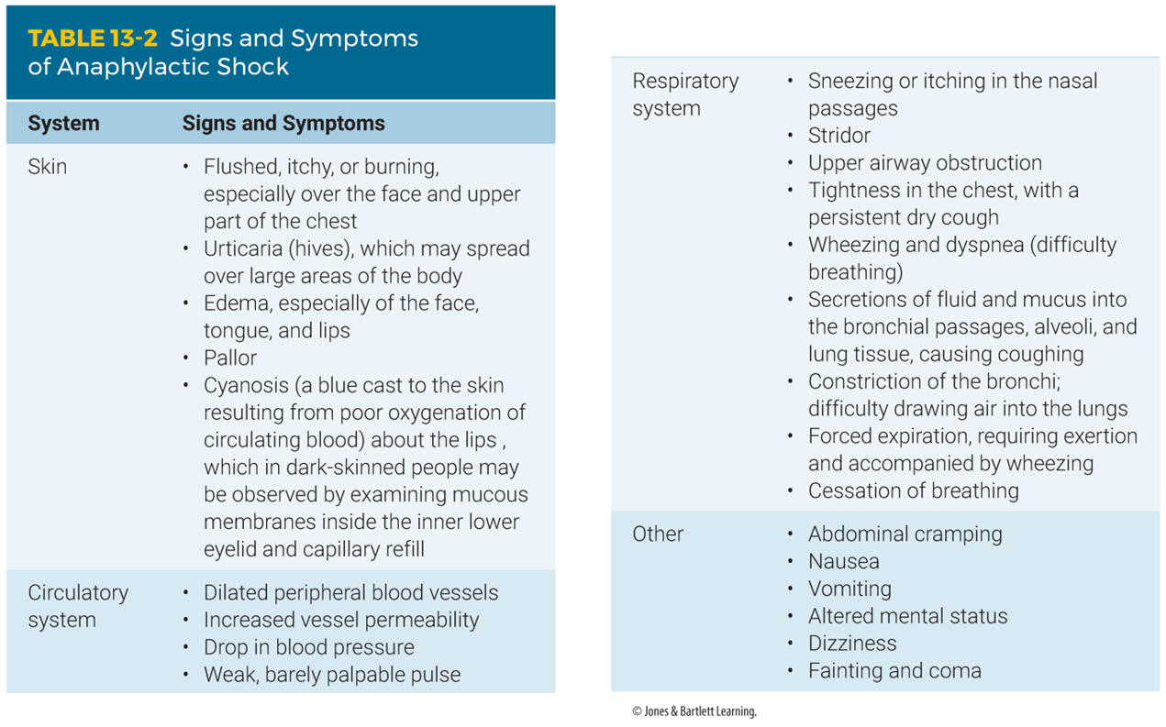
Distributive Shock (6 of 8)
Notes:
The table on this slide lists the signs and symptoms of anaphylactic shock.

Slide 32
Distributive Shock (7 of 8)
Psychogenic shock
  Caused by a sudden reaction of the nervous system
  Produces temporary, generalized vascular dilation
  Results in fainting (syncope)
Notes:
Lecture Outline
6. Psychogenic shock
a. A patient in psychogenic shock has had a sudden reaction of the nervous system that produces a temporary, generalized vascular dilation, resulting or syncope.

Slide 33
Distributive Shock (8 of 8)
Psychogenic shock (cont’d)
  Life-threatening causes include irregular heartbeat and brain aneurysm.
  Non–life-threatening events include receipt of bad news or experiencing fear or unpleasant sights (such as blood).
Notes:
Lecture Outline

Slide 34
Hypovolemic Shock
Result of an inadequate amount of fluid or volume in the circulatory system
Hemorrhagic causes and nonhemorrhagic causes
Occurs with severe thermal burns
Notes:
Lecture Outline
D. Hypovolemic shock
1. The result of an inadequate amount of fluid or volume in the circulatory system
2. There are hemorrhagic causes and nonhemorrhagic causes.
3. Also occurs with severe thermal burns

Slide 35
The Progression of Shock (1 of 4)
Stages in the progression of shock:
  Compensated shock: early stage when the body can still compensate for blood loss
  Decompensated shock: late stage when blood pressure is falling
  No way to assess when effects are irreversible
  Must recognize and treat shock early
Notes:
Lecture Outline
V. The Progression of Shock
A. The stages in the progression of shock
1. Compensated shock
2. Decompensated shock
3. When shock has progressed too far:
a. It is irreversible.
b. No way to assess when a patient has reached this point
c. Recognize and treat shock early—well before the patient transitions into the decompensated phase.

Slide 36
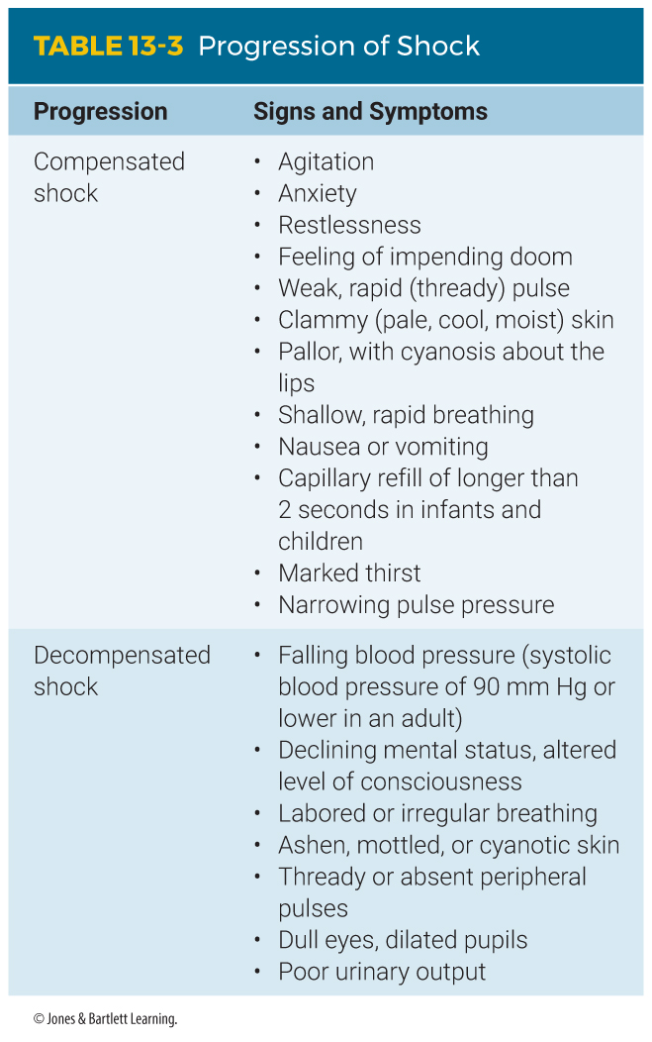
The Progression of Shock (2 of 4)
Notes:
The table on this slide lists the signs and symptoms of compensated and decompensated shock.

Slide 37
The Progression of Shock (3 of 4)
Blood pressure may be the last measurable factor to change in shock.
  When a drop in blood pressure is evident, shock is well developed.
  Particularly true in infants and children
  When blood pressure drops in infants and children in shock, they are close to death.
Notes:
Lecture Outline
4. Blood pressure may be the last measurable factor to change in shock.
a. When a drop in blood pressure is evident, shock is well developed.
b. This is particularly true in infants and children, who can maintain their blood pressure until they have blood loss that is more than half their blood volume.
c. By the time blood pressure drops in infants and children who are in shock, they are close to death.
5. Expect shock in many emergency medical situations.

Slide 38
The Progression of Shock (4 of 4)
Also expect shock if a patient has any one of the following conditions:
  Multiple severe fractures
  Abdominal or chest injury
  Spinal injury
  A severe infection
  A major heart attack
  Anaphylaxis
Notes:
Lecture Outline
6. Also expect shock if a patient has any one of the following conditions:
a. Multiple severe fractures
b. Abdominal or chest injury
c. Spinal injury
d. A severe infection
e. A major heart attack
f. Anaphylaxis

Slide 39
Scene Size-up
Scene size-up
  Be alert to potential hazards to your safety.
  Use gloves and eye protection for trauma scenes or if bleeding is suspected.
  Mechanism of injury/nature of illness
Notes:
Lecture Outline
VI. Patient Assessment for Shock
A. Scene size-up
1. Scene safety
2. Mechanism of injury/nature of illness

Slide 40
Primary Assessment (1 of 5)
Primary assessment
  Perform a rapid exam.
  Determine the level of consciousness.
  Identify and manage life-threatening concerns.
  Determine priority of the patient and transport.
Notes:
Lecture Outline
B. Primary assessment
1. The primary assessment for a patient with suspected shock should include a rapid exam to:
a. Determine level of consciousness
b. Identify and manage life-threatening concerns as they are found
c. Determine priority of the patient and transport
i. A patient with massive hemorrhage may require a tourniquet (or direct pressure dressings when tourniquets are not feasible or available) before the airway is opened.
ii. If the patient has life-threatening external bleeding, it should be addressed first (even before airway and breathing), then the ABCs can be assessed and treated, and treatments for shock provided.

Slide 41
Primary Assessment (2 of 5)
Primary assessment (cont’d)
  Provide high-flow oxygen to assist in perfusion.
  For hypoperfusion, treat aggressively and provide rapid transport.
  Request advanced life support (ALS) as necessary.
Notes:
Lecture Outline
2. Provide high-flow oxygen to assist in perfusion of damaged tissues.
a. If the patient has signs of hypoperfusion, treat aggressively and provide rapid transport to the hospital.
b. Request advanced life support (ALS) as necessary to assist with more aggressive shock management.

Slide 42
Primary Assessment (3 of 5)
Primary assessment (cont’d)
  Form a general impression.
  Assess the airway to ensure it is patent.
  Assess breathing.
  An increased respiratory rate is often an early sign of impending shock.
  Assess patient’s circulatory status.
Notes:
Lecture Outline
Form a general impression.
Determine the need for manual spinal stabilization and assess the patient’s level of consciousness.
5. Airway and breathing
a. Assess the airway to ensure it is patent.
b. Quickly assess breathing.
6. Circulation
a. Assessing the patient’s circulatory status can reveal important clues regarding the presence of shock.

Slide 43
Primary Assessment (4 of 5)
Primary assessment (cont’d)
  A rapid pulse suggests compensated shock.
  In shock or compensated shock, the skin may be cool, clammy, or ashen.
  Assess for and identify any life-threatening bleeding and treat it at once.
Notes:
Lecture Outline
b. Check for a distal pulse.
c. If there is none, check for a central pulse.
d. Determine if the pulse is fast, slow, weak, strong, or altogether absent.
i. A rapid pulse suggests compensated shock.
ii. In shock or compensated shock, the skin may be cool, clammy, or ashen.
e. If the patient has no pulse and is not breathing, immediately begin cardiopulmonary resuscitation (CPR).
f. Assess for and identify any life-threatening bleeding in trauma patients.
i. Treat it immediately when found.
g. Quickly assess skin temperature condition, and color, and check for capillary refill time.

Slide 44
Primary Assessment (5 of 5)
Primary assessment (cont’d)
  Determine if patient is high priority, if ALS is needed, and which facility to transport to.
  Trauma patients with shock or a suspicious MOI generally should go to a trauma center.
Notes:
Lecture Outline
7. Transport decision
a. Determine whether the patient should be treated as high priority, whether ALS is needed, and which facility to transport to.

Slide 45
History Taking
History taking
  Determine the chief complaint.
  Obtain a SAMPLE history.
Notes:
Lecture Outline
C. History taking
1. After life threats have been managed, determine the chief complaint.
2. Obtain a SAMPLE history.

Slide 46
Secondary Assessment
Secondary assessment
  Repeat the primary assessment, followed by focused assessment.
  If a life-threatening problem is found, treat it immediately.
  Obtain a complete set of baseline vital signs.
  Use monitoring devices.
Notes:
Lecture Outline
D. Secondary assessment
1. Physical examinations
a. Repeat the primary assessment followed by a focused assessment.
b. Perform a secondary assessment of the entire body if:
i. Your patient is a trauma patient with a significant mechanism of injury or multiple injuries
ii. Your patient gives you a poor initial general impression
iii. You found problems in the primary assessment
iv. Your patient has a medical problem but is not responsive
v. Your patient has problems that were not noted in the primary assessment
c. These assessments should be performed quickly but thoroughly to ensure that you do not miss any significant or life-threatening problems or delay needed care.
d. Whether your examination is of the entire body or of a specific area, if a life-threatening problem is found, treat it immediately.
2. Vital signs

Slide 47
Reassessment (1 of 2)
Reassessment
  Reassess the patient’s:
    Vital signs
    Interventions
    Chief complaint
    ABCs
    Mental status
Notes:
Lecture Outline
E. Reassessment
1. Reassess the patient’s:
a. Vital signs
b. Interventions
c. Chief complaint
d. ABCs
e. Mental status

Slide 48
Reassessment (2 of 2)
Reassessment (cont’d)
  Determine what interventions are needed.
  Focus on supporting the cardiovascular system.
  Treat for shock early and aggressively by:
    Providing oxygen
    Keeping the patient warm
Notes:
Lecture Outline
2. Determine what interventions are needed for your patient based on the assessment findings.
a. Focus on supporting the cardiovascular system.
b. Treat for shock early and aggressively by providing oxygen and keeping the patient warm.

Slide 49
Emergency Medical Care for Shock (1 of 3)
As soon as you recognize shock, begin treatment.
  Follow standard precautions.
  Control all obvious bleeding.
  Make sure the patient has an open airway.
  Maintain manual in-line stabilization if necessary, and check breathing and pulse.
Notes:
Lecture Outline
VII. Emergency Medical Care for Shock
A. You must begin immediate treatment for shock as soon as you realize that the condition may exist.
1. Follow standard precautions.
2. Control all obvious external bleeding.
3. Make sure the patient has an open airway.
4. Maintain manual in-line stabilization if necessary, and check breathing and pulse.

Slide 50
Emergency Medical Care for Shock (2 of 3)
As soon as you recognize shock, begin treatment. (cont’d)
  Comfort, calm, and reassure the patient.
  Never allow patients to eat or drink anything prior to being evaluated by a physician.
  If spinal immobilization is indicated, splint the patient on a backboard.
  Provide oxygen and monitor patient’s breathing.
Notes:
Lecture Outline
5. Comfort, calm, and reassure the patient, while maintaining the patient in the supine position.
6. Never allow patients to eat or drink anything prior to being evaluated by a physician.
7. If spinal immobilization is indicated, splint the patient on a backboard.
8. Remember that inadequate ventilation may be a major factor in the development of shock. Always provide oxygen, assist with ventilations, and use airway control adjuncts as needed.

Slide 51
Emergency Medical Care for Shock (3 of 3)
As soon as you recognize shock, begin treatment. (cont’d)
  Place blankets under and over the patient.
  Consider the need for ALS.
  Accurately record the patient’s vital signs approximately every 5 minutes throughout treatment and transport.
Notes:
Lecture Outline
To prevent the loss of body heat, place blankets under and over the patient.
Transport the patient and treat additional injuries en route.
11. Consider rendezvous with ALS if possible, and consider aeromedical transport.
12. Accurately record the patient’s vital signs approximately every 5 minutes throughout treatment and transport.

Slide 52
Treating Cardiogenic Shock (1 of 3)
Patient cannot generate the necessary contraction to pump blood throughout the circulatory system.
Patients may present with chest pain.
Patients in cardiogenic shock should not receive nitroglycerin; they are hypotensive.
Notes:
Lecture Outline
B. Treating cardiogenic shock
1. The patient who is in shock as a result of a heart attack simply cannot generate the necessary power to pump blood throughout the circulatory system.
2. Usually, patients with cardiogenic shock do not have any injury, but they may be having chest pain.
3. Patients in cardiogenic shock should not receive nitroglycerin; by definition they are hypotensive.

Slide 53
Treating Cardiogenic Shock (2 of 3)
Patients usually have:
  Low blood pressure
  Weak, irregular pulse
  Cyanosis about lips/underneath fingernails
  Anxiety
  Nausea
Notes:
Lecture Outline
5. Signs and symptoms include:
a. Weak, irregular pulse
b. Cyanosis about the lips and underneath the fingernails
c. Anxiety
d. Nausea

Slide 54
Treating Cardiogenic Shock (3 of 3)
Place the patient in a position that eases breathing as you give high-flow oxygen.
Assist ventilations as necessary.
Provide prompt transport.
Consider meeting ALS en route to hospital.
Notes:
Lecture Outline
5. Place the patient in a position that eases breathing as you give high-flow oxygen.
6. Initiate prompt transport. If ALS is not on-scene, consider arranging for a rendezvous en route.

Slide 55
Treating Obstructive Shock (1 of 2)
For cardiac tamponade:
  Increasing cardiac output is the priority.
  Apply high-flow oxygen.
  Surgery is the only definitive treatment.
Notes:
Lecture Outline
C. Treating obstructive shock
1. For cardiac tamponade
a. Increasing cardiac output should be the priority.
b. Apply high-flow oxygen.
c. Surgery is the only definitive treatment.

Slide 56
Treating Obstructive Shock (2 of 2)
For tension pneumothorax:
  Apply high-flow oxygen to prevent hypoxia.
  Chest decompression is required.
  Ask for ALS early in call if available, but do not delay transport.
Notes:
Lecture Outline
2. For tension pneumothorax
a. Administer high-flow oxygen via nonrebreathing mask early to prevent hypoxia.
b. Chest decompression is required to relieve the pressure in the chest.
c. Chest decompression is an ALS skill. Ask for ALS assistance early in the call if available; however, do not delay transport waiting for the arrival of ALS.

Slide 57
Treating Septic Shock
Hospital management is required.
Use standard precautions and transport.
Administer high-flow oxygen.
Ventilatory support may be necessary.
Use blankets to conserve body heat.
Notify “sepsis team” if available.
Notes:
Lecture Outline
D. Treating septic shock
1. The proper treatment of septic shock requires complex hospital management, including administration of antibiotics.
2. Use appropriate standard precautions and transport as promptly as possible.
3. Administer high-flow oxygen during transport and support ventilations as needed.
4. Preserve body heat.
5. Notify a specialized “sepsis team” if available to meet the patient in the ED.

Slide 58
Treating Neurogenic Shock
Emergency treatment:
  Obtain and maintain a proper airway.
  Provide spinal immobilization.
  Assist inadequate breathing.
  Conserve body heat.
  Ensure the most effective circulation.
Transport promptly.
Notes:
Lecture Outline
1. Emergency treatment must be directed at:
a. Obtaining and maintaining a proper airway
b. Providing spinal immobilization
c. Assisting inadequate breathing as needed
d. Conserving body heat
e. Ensuring the most effective circulation possible
2. Transport the patient promptly to a facility capable of managing spinal injuries.

Slide 59
Treating Anaphylactic Shock
Administer epinephrine.
Promptly transport the patient.
Provide high-flow oxygen and ventilatory assistance en route.
A mild reaction may worsen suddenly.
Consider requesting ALS backup, if available.
Notes:
Lecture Outline
F. Treating anaphylactic shock
1. The most effective treatment for a severe, acute allergic reaction is to administer epinephrine by way of intramuscular injection.
2. A patient with anaphylaxis requires immediate transport.
a. Administer high-flow oxygen (10 to 15 L/min via a nonrebreathing mask).
b. Assist ventilations with a bag-mask device if necessary.
c. Try to find out what agent caused the reaction and how it was received.
3. Keep in mind that a mild reaction may worsen suddenly or over time.
4. Because of the potential for airway compromise, consider requesting ALS backup, if available.

Slide 60
Treating Psychogenic Shock (1 of 2)
In an uncomplicated case of fainting, once the patient collapses, circulation to the brain is restored.
Psychogenic shock can worsen other types of shock.
If the patient falls, check for injuries.
Notes:
Lecture Outline
G. Treating psychogenic shock
1. In an uncomplicated case of fainting, once the patient collapses and becomes supine, circulation to the brain is restored and, with it, a normal state of functioning.
2. Psychogenic shock can worsen other types of shock.
3. If it appears the patient fell as a result of psychogenic shock, check for injuries, especially in older patients.

Slide 61
Treating Psychogenic Shock (2 of 2)
If the patient reports being unable to walk after a fall, suspect another problem.
Transport the patient promptly.
Notes:
Lecture Outline
4. If the patient reports not being able to walk after a fall thought to be related to psychogenic shock, you should suspect another problem, such as head injury.
5. Transport the patient promptly.
a. All patients with loss of consciousness should be transported to the ED for evaluation even if they appear normal once you arrive on scene.

Slide 62
Treating Hypovolemic Shock
Control all obvious external bleeding.
Keep the patient warm.
Recognize internal bleeding and provide aggressive support.
Secure and maintain an airway, and provide respiratory support.
Transport as rapidly as possible.
Notes:
Lecture Outline
H. Treating hypovolemic shock
1. Control all obvious external bleeding.
a. The best initial method to control external bleeding is direct pressure.
b. If bleeding is not controlled with direct pressure, consider using a tourniquet.
2. Handle the patient gently and keep him or her warm.
3. Recognize internal bleeding and provide aggressive general support.
4. Secure and maintain an airway, and provide respiratory support, including supplemental oxygen and, if needed, assisted ventilations.
5. Transport the patient as rapidly as possible to the ED.

Slide 63
Treating Shock in Older Patients
Older patients have more serious complications than younger ones.
Illness is not just a part of aging.
Many older patients take medications that mask or mimic signs of shock.
Notes:
Lecture Outline
I. Treating shock in the older patients
1. Older patients generally have more serious complications than younger patients.
2. Many older patients take numerous medications that could either mask or mimic signs of shock.
3. Treating a pediatric or geriatric patient in shock is no different than treating any other shock patient.
a. Provide in-line spinal stabilization if indicated. If spinal immobilization is not indicated, maintain the patient in a position of comfort.
b. Control life-threatening hemorrhage immediately with direct pressure or tourniquet application when appropriate.
c. Suction as necessary and provide high-flow oxygen via a nonrebreathing mask.
d. Maintain body temperature.
e. Provide rapid transportation.

Slide 64
Review
The term “shock” is MOST accurately defined as:
  a decreased supply of oxygen to the brain.
  cardiovascular collapse leading to inadequate perfusion.
  decreased circulation of blood within the venous circulation.
  decreased function of the respiratory system leading to hypoxia.

Slide 65
Review
Answer: B
Response: Shock, or hypoperfusion, refers to a state of collapse and failure of the cardiovascular system, or any one of its components (eg, heart, vasculature, blood volume), which leads to inadequate perfusion of the body’s cells and tissues.

Slide 66
Review
The term “shock” is MOST accurately defined as:
  a decreased supply of oxygen to the brain.
  Rationale: It may be a result of inadequate perfusion, but it is not the definition of shock.
  cardiovascular collapse leading to inadequate perfusion.
  Rationale: Correct answer
  decreased circulation of blood within the venous circulation.
  Rationale: It may be a result of cardiovascular collapse, but it is not the definition of shock.
  decreased function of the respiratory system leading to hypoxia.
  Rationale: Decreased function of the respiratory system will lead to hypoxia, which will cause cardiovascular collapse and eventually shock.

Slide 67
Review
Anaphylactic shock is typically associated with:
  urticaria.
  bradycardia.
  localized welts.
  a severe headache.

Slide 68
Review
Answer: A
Rationale: Urticaria (hives) is typically associated with allergic reactions—mild, moderate, and severe. They are caused by the release of histamines from the immune system. In anaphylactic shock, urticaria is also accompanied by cool, clammy skin; tachycardia; severe respiratory distress; and hypotension.

Slide 69
Review
Anaphylactic shock is typically associated with:
  urticaria.
  Rationale: Correct answer
  bradycardia.
  Rationale: Tachycardia, not bradycardia, is a symptom of anaphylactic shock.
  localized welts.
  Rationale: Welts are a raised ridge or bump on the skin caused by a lash from a whip, a scratch, or a similar blow.
  a severe headache.
  Rationale: Altered mental status secondary to hypoxia may be a symptom, but not a headache.

Slide 70
Review
Signs of compensated shock include all of the following, EXCEPT:
  restlessness or anxiety.
  pale, cool, clammy skin.
  a feeling of impending doom.
  weak or absent peripheral pulses.

Slide 71
Review
Answer: D
Rationale: In compensated shock, the body is able to maintain perfusion to the vital organs of the body via the autonomic nervous system. Signs include pale, cool, clammy skin; restlessness or anxiety; a feeling of impending doom; and tachycardia. When the body’s compensatory mechanism fails, the patient’s blood pressure falls; weak or absent peripheral pulses indicates this.

Slide 72
Review
Signs of compensated shock include all of the following, EXCEPT:
  restlessness or anxiety.
  Rationale: This indicates compensated shock.
  pale, cool, clammy skin.
  Rationale: This indicates compensated shock.
  a feeling of impending doom.
  Rationale: This indicates compensated shock and the anxiety associated with it.
  weak or absent peripheral pulses.
  Rationale: Correct answer

Slide 73
Review
When treating a trauma patient who is in shock, LOWEST priority should be given to:
  spinal protection.
  thermal management.
  splinting fractures.
  notifying the hospital.

Slide 74
Review
Answer: C
Rationale: Critical interventions for a trauma patient in shock include spinal precautions, high-flow oxygen (or assisted ventilation), thermal management, rapid transport, and early notification of a trauma center. Splinting fractures should not be performed at the scene if the patient is critically injured; it takes too long and only delays transport.

Slide 75
Review
When treating a trauma patient who is in shock, LOWEST priority should be given to:
  spinal protection.
  Rationale: Stabilization of the spine must take place during the first interaction with a trauma patient.
  thermal management.
  Rationale: Preventing hypothermia is standard treatment.
  splinting fractures.
  Rationale: Correct answer
  notifying the hospital.
  Rationale: Trauma centers need to be notified early during patient interaction and transport.

Slide 76
Review
Potential causes of cardiogenic shock include all of the following, EXCEPT:
  inadequate heart function.
  disease of muscle tissue.
  severe bacterial infection.
  impaired electrical system.

Slide 77
Review
Answer: C
Rationale: Cardiogenic shock is caused by inadequate function of the heart, or pump failure. Within certain limits, the heart can adapt to these problems. If too much muscular damage occurs, however, as sometimes happens after a heart attack, the heart no longer functions well. Other causes include disease, injury, and an impaired electrical system.

Slide 78
Review
Potential causes of cardiogenic shock include all of the following EXCEPT:
  inadequate heart function.
  Rationale: This is a cause of cardiogenic shock.
  disease of muscle tissues.
  Rationale: This is a cause of cardiogenic shock.
  severe bacterial infection.
  Rationale: Correct answer.
  impaired electrical system.
  Rationale: This is a cause of cardiogenic shock.

Slide 79
Review
A 60-year-old woman presents with a BP of 80/60 mm Hg, a pulse rate of
110 beats/min, mottled skin, and a temperature of 103.9°F. She is MOST likely experiencing:
  septic shock.
  neurogenic shock.
  profound heart failure.
  a severe viral infection.

Slide 80
Review
Answer: A
Rationale: In septic shock, bacterial toxins damage the blood vessel walls, causing them to leak and rendering them unable to constrict. Widespread dilation of the vessels, in combination with plasma loss through the injured vessel walls, results in shock. A high fever commonly accompanies a bacterial infection.

Slide 81
Review
A 60-year-old woman presents with a BP of 80/60 mm Hg, a pulse rate of 110 beats/min, mottled skin, and a temperature of 103.9°F.
She is MOST likely experiencing:
  septic shock.
  Rationale: Correct answer
  neurogenic shock.
  Rationale: Neurogenic shock is an injury to the nervous system and shows bradycardia and hypotension—not fever.
  profound heart failure.
  Rationale: This is part of cardiogenic shock, associated with low blood pressure, weak pulse, and cyanotic skin.
  a severe viral infection.
  Rationale: Septic shock is caused by a bacterial infection.

Slide 82
Review
A patient with neurogenic shock would be LEAST likely to present with:
  tachypnea.
  hypotension.
  tachycardia.
  altered mentation.

Slide 83
Review
Answer: C
Rationale: In neurogenic shock, the nerves that control the sympathetic nervous system are compromised. The nervous system is responsible for secreting the hormones epinephrine and norepinephrine, which increase the patient’s heart rate, constrict the peripheral vasculature, and shunt blood to the body’s vital organs. Without the release of these hormones, the compensatory effects of tachycardia and peripheral vasoconstriction are absent.

Slide 84
Review
A patient with neurogenic shock would be LEAST likely to present with:
  tachypnea.
  Rationale: Respirations increase to compensate for the hypoxia associated with shock.
  hypotension.
  Rationale: Hypotension results from massive vasodilation.
  tachycardia.
  Rationale: Correct answer
  altered mentation.
  Rationale: The patient will present with mental status changes secondary to hypoxia.

Slide 85
Review
A 20-year-old man was kicked numerous times in the abdomen during an assault. His abdomen is rigid and tender, his heart rate is 120 beats/min, and his respirations are 30 breaths/min. You should treat this patient for:
  a lacerated liver.
  a ruptured spleen.
  respiratory failure.
  hypovolemic shock.

Slide 86
Review
Answer: D
Rationale: The patient may have a liver laceration or ruptured spleen—both of which can cause internal blood loss. However, it is far more important to recognize that the patient is in hypovolemic shock and to treat him accordingly.

Slide 87
Review
A 20-year-old man was kicked numerous times in the abdomen during an assault. His abdomen is rigid and tender, his heart rate is 120 beats/min, and his respirations are 30 breaths/min. You should treat this patient for:
  a lacerated liver.
  Rationale: You cannot treat a lacerated liver in the field. You can treat the symptoms of hypovolemic shock associated with the injury.
  a ruptured spleen.
  Rationale: You cannot treat a ruptured spleen in the field. You can treat the symptoms of hypovolemic shock associated with the injury.
  respiratory failure.
  Rationale: If you treat the hypovolemic shock, then you will treat the respiratory compromise as well.
  hypovolemic shock.
  Rationale: Correct answer

Slide 88
Review
A 33-year-old woman presents with a generalized rash, facial swelling, and hypotension approximately 10 minutes after being stung by a hornet. Her BP is 70/50 mm Hg and her heart rate is 120 beats/min. In addition to high-flow oxygen, this patient is in MOST immediate need of:
  epinephrine.
  rapid transport.
  an antihistamine.
  IV fluids.

Slide 89
Review
Answer: A
Rationale: This patient is in anaphylactic shock—a life-threatening overexaggeration of the immune system that results in bronchoconstriction and hypotension. After ensuring adequate oxygenation and ventilation, the MOST important treatment for the patient is epinephrine, which dilates the bronchioles and constricts the vasculature, thus improving breathing and blood pressure, respectively.

Slide 90
Review
A 33-year-old woman presents with a generalized rash, facial swelling, and hypotension approximately 10 minutes after being stung by a hornet. Her BP is 70/50 mm Hg and her heart rate is 120 beats/min. In addition to high-flow oxygen, this patient is in MOST immediate need of:
  epinephrine.
  Rationale: Correct answer
  rapid transport.
  Rationale: Rapid transport follows high-flow oxygen and epinephrine administration.
  an antihistamine.
  Rationale: This is an ALS treatment.
  IV fluids.
  Rationale: This is an ALS treatment.

Slide 91
Review
All of the following are potential causes of impaired tissue perfusion, EXCEPT:
  increased number of red blood cells.
  pump failure.
  low fluid volume.
  poor vessel function.

Slide 92
Review
Answer: A
Rationale: An increased number of red blood cells would allow adequate oxygen and nutrients to be delivered to the cells.

Slide 93
Review
All of the following are potential causes of impaired tissue perfusion, EXCEPT:
  increased number of red blood cells.
  Rationale: Correct answer
  pump failure.
  Rationale: Pump failure is a cause of impaired tissue perfusion.
  low fluid volume.
  Rationale: Poor vessel function is a cause of impaired tissue perfusion.
  poor vessel function.
  Rationale: Poor vessel function is a cause of impaired tissue perfusion.

